Slide 1

Instructor Romasha Khurshid
Welcome To My Software Engineering Class

Slide 2

Tentative Marks Distribution
Assignment+ Class Participation --------- 10 Marks
Sessional------------------ 15+15 Marks
Final------------------------- 50 Marks
Project---------------------- 10 Marks

Slide 3
Course Material:
Books:
Software Engineering by Ian Sommerville (10 edition)
Software Engineering Practitioner’s Approach by Roger S. Pressman (Seventh Edition)
Reading Material:
Articles Readings.

Slide 4

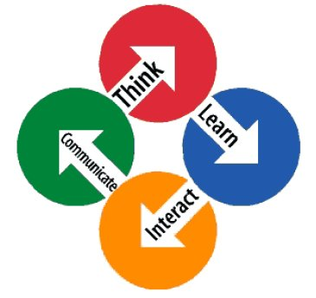
Course Learning Outcomes:
Have a sound understanding of the fundamental concepts of the software engineering paradigm.
Understand and apply the different common practices used in software industry for the analysis, design and production of software.
Analyze, design and implement practical systems of up to average complexity within a team.
Familiarity with concepts of software quality and testing.

Slide 5
Warm-Up Activity:
What are you expecting from this course?
Briefly Describe what do you know about Software engineering?
Briefly describe your understanding in SDA?

Slide 6
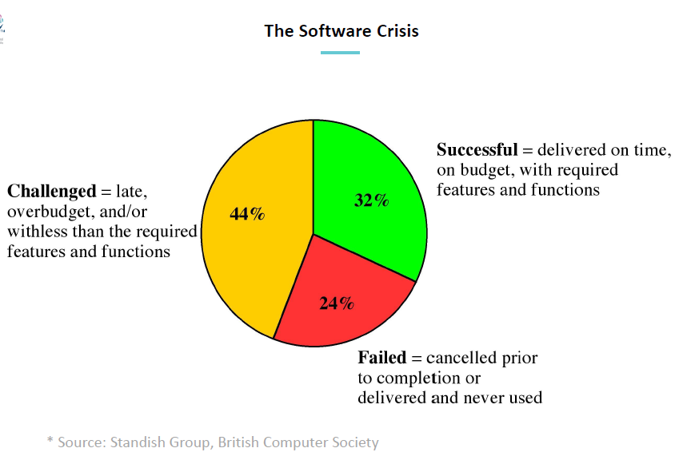

Slide 7
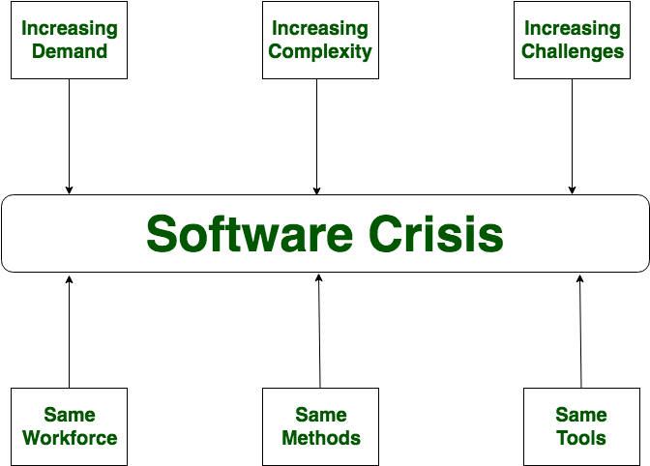
software industry’s inability to provide customers with high quality products on schedule.
Projects ran over-budget.
Damage to property even to life.

Slide 8
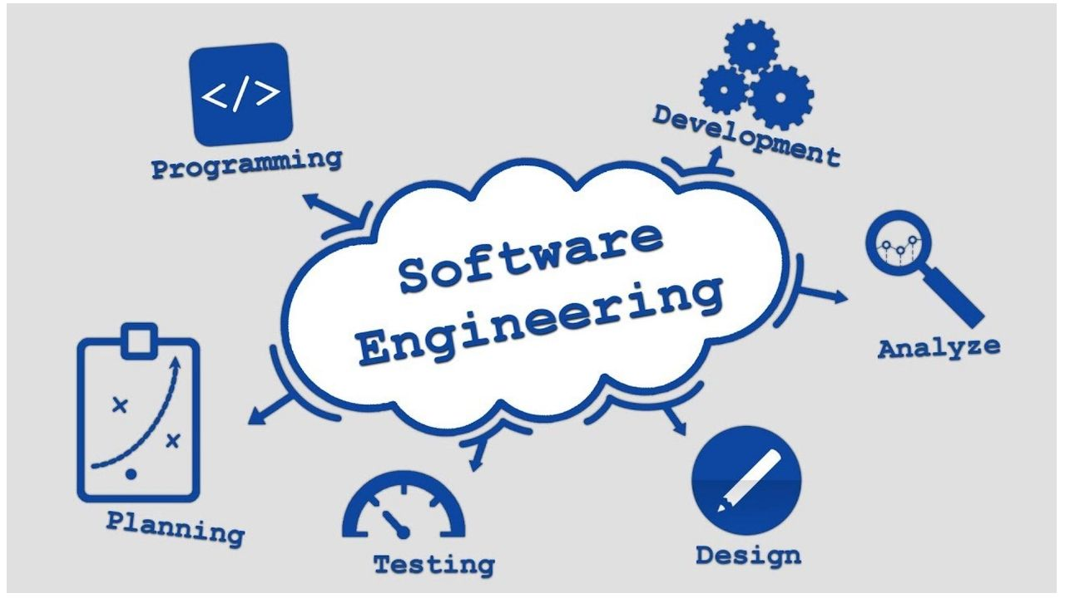
What is software Engineering:
Software engineering is an engineering discipline that is concerned with all aspects of software production from the early stages of system specification through to maintaining the system after it has gone into use.

Slide 9

Key Phrases:
Engineering discipline
Using appropriate theories and methods to solve problems bearing in mind organizational and financial constraints.
All aspects of software production
Not just technical process of development. Also project management and the development of tools, methods etc. to support software production.

Slide 10
Software project failure
Increasing system complexity
As new software engineering techniques help us to build larger, more complex systems, the demands change. Systems must be built and delivered more quickly; larger, even more complex systems are required; systems must have new capabilities that were previously thought to be impossible.
Failure to use software engineering methods
It is easy to write computer programs without using software engineering methods and techniques. Many companies have drifted into software development as their products and services have evolved. They do not use software engineering methods in their everyday work. Consequently, their software is often more expensive and less reliable than it should be.

Slide 11
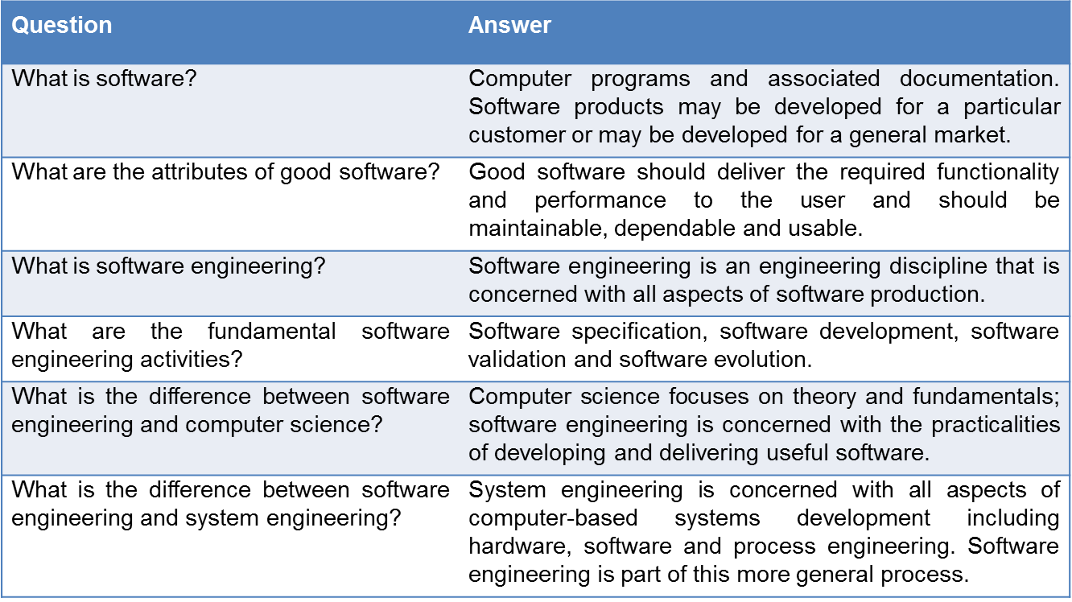
Professional software development:
Frequently asked questions about software engineering

Slide 12
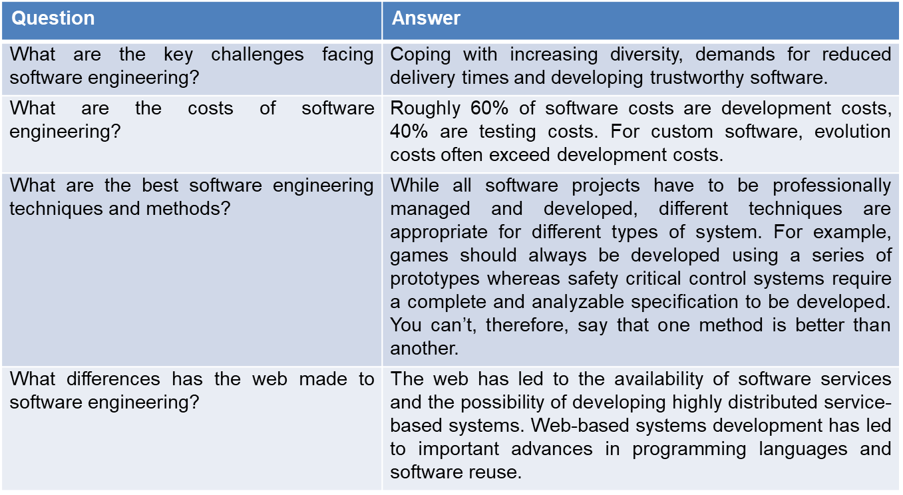
Frequently asked questions about software engineering

Slide 13
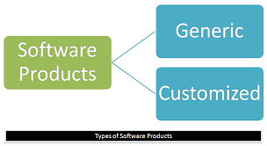
Software products
Generic products:
Stand-alone systems that are marketed and sold to any customer who wishes to buy them.
Customized products:
Software that is commissioned by a specific customer to meet their own needs.

Slide 14
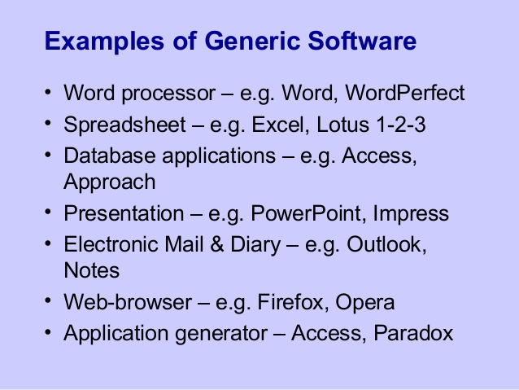

Slide 15
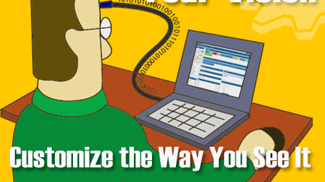
Product specification:
Generic products
The specification of what the software should do is owned by the software developer and decisions on software change are made by the developer.
Customized products
The specification of what the software should do is owned by the customer for the software and they make decisions on software changes that are required.

Slide 16
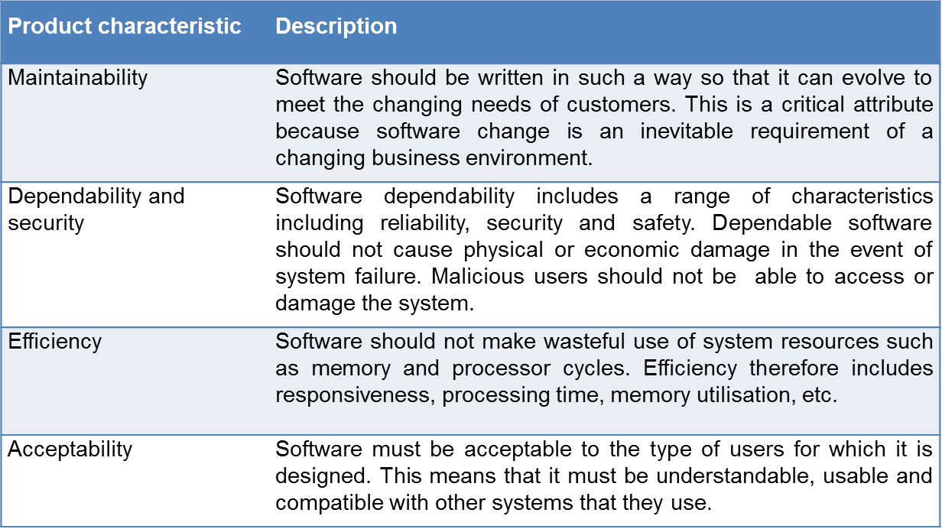
Essential attributes of good software:

Slide 17
Importance of software engineering
Individuals and society rely on advanced software systems.
We need to be able to produce reliable and trustworthy systems economically and quickly.
It is usually cheaper, in the long run, to use software engineering methods and techniques for software systems.
For most types of system, the majority of costs are the costs of changing the software after it has gone into use.

Slide 18

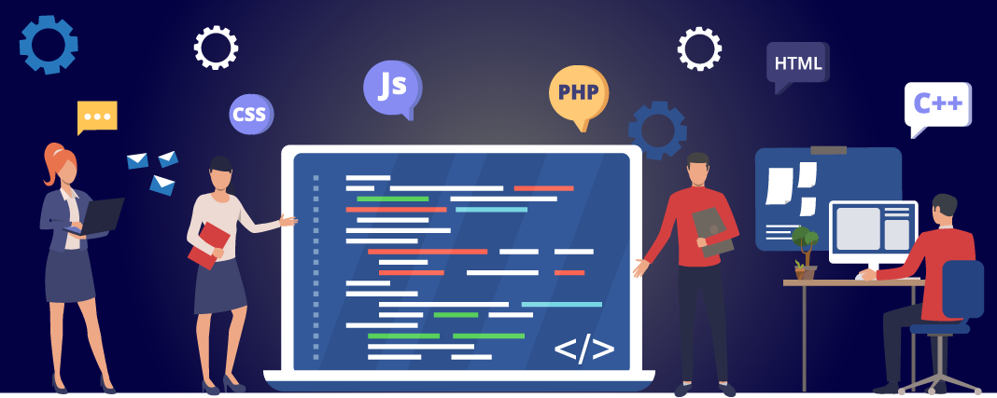
Software process activities:
Software specification, where customers and engineers define the software that is to be produced and the constraints on its operation.
2. Software development, where the software is designed and programmed.

Slide 19
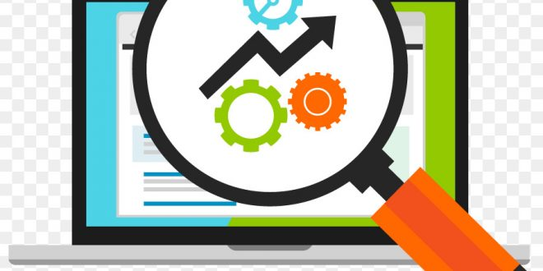

Software process activities:
3. Software validation, where the software is checked to ensure that it is what the customer requires.
4. Software evolution, where the software is modified to reflect changing customer and market requirements.

Slide 20
Software engineering diversity:
There are many different types of software system and there is no universal set of software techniques that is applicable to all of these.
The software engineering methods and tools used depend on the type of application being developed, the requirements of the customer and the background of the development team.

Slide 21
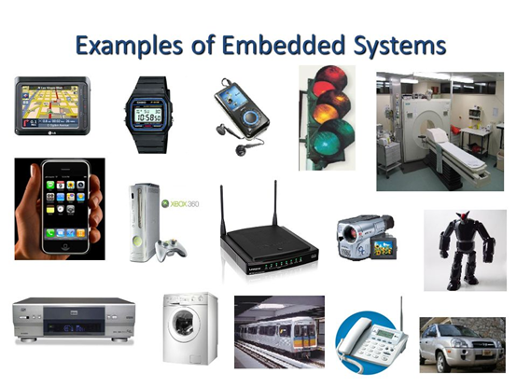
Application types:
Stand-alone applications:
These are application systems that run on a local computer, such as a PC. They include all necessary functionality and do not need to be connected to a network.
Interactive transaction-based applications:
Applications that execute on a remote computer and are accessed by users from their own PCs or terminals. These include web applications such as e-commerce applications.
Embedded control systems:
These are software control systems that control and manage hardware devices. Numerically, there are probably more embedded systems than any other type of system.

Slide 22
Continue…
Batch processing systems :
These are business systems that are designed to process data in large batches. They process large numbers of individual inputs to create corresponding outputs.
Entertainment systems :
These are systems that are primarily for personal use and which are intended to entertain the user.
Systems for modelling and simulation:
These are systems that are developed by scientists and engineers to model physical processes or situations, which include many, separate, interacting objects.

Slide 23
Continue…
Data collection systems:
These are systems that collect data from their environment using a set of sensors and send that data to other systems for processing.
Systems of systems:
These are systems that are composed of a number of other software systems.

Slide 24
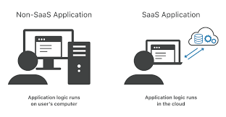
Internet software engineering:
The Web is now a platform for running application and organizations are increasingly developing web-based systems rather than local systems.
Cloud computing is an approach to the provision of computer services where applications run remotely on the ‘cloud’.
Users do not buy software but pay according to use.
The fundamental ideas of software engineering apply to web-based software in the same way that they apply to other types of software system

Slide 25
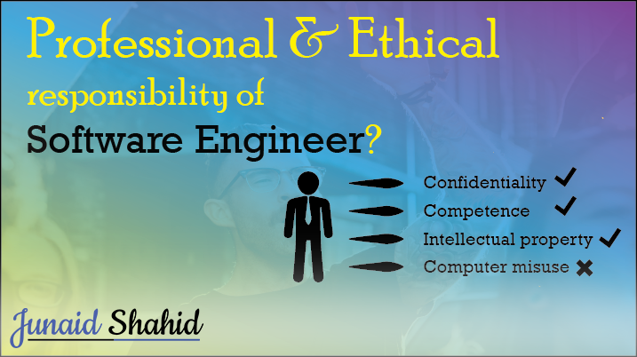
Software engineering ethics
Software engineers must be honest and ethically responsible about his job.
Read Ian Somerville's chap 01 for further details

Slide 26
Case Studies

Slide 27

1. Insulin Pump Control System
Collects data from a blood sugar sensor and calculates the amount of insulin required to be injected.
Calculation based on the rate of change of blood sugar levels.
Sends signals to a micro-pump to deliver the correct dose of insulin.
Safety-critical system as low blood sugars can lead to brain malfunctioning, coma and death; high-blood sugar levels have long-term consequences such as eye and kidney damage.

Slide 28
Essential high-level requirements
The system shall be available to deliver insulin when required.
The system shall perform reliably and deliver the correct amount of insulin to counteract the current level of blood sugar.
The system must therefore be designed and implemented to ensure that the system always meets these requirements.

Slide 29
Insulin pump hardware architecture

Slide 30
Activity model of the insulin pump

Slide 31
Issues with embedded systems
Physical size
Responsiveness
Power Management

Slide 32
Mentcare A patient information system for mental health care:
Mentcare is an information system that is intended for use in clinics.
Maintains information about patients suffering from mental health
Maintains treatments records that they have received.
Centralized database of patient information but also been designed to run on a PC.

Slide 33
Critical Requirements:
Safety and Privacy are the critical requirement of the given system.
The system must be available when needed otherwise safety may be compromised and it may be impossible to prescribe the correct medication to patients.
Privacy is easiest to maintain with single copy of record.
However, to ensure availability, multiple copies of the data should be
maintained.
I discuss the trade-offs between these requirements in later chapters

Slide 34
The organization of the Mentcare system

Slide 35
Key features of the Mentcare system
Individual care management
Patient monitoring
Administrative reporting

Slide 36

Wilderness weather station:
Weather stations collect data from a set of instruments that measure temperature and pressure, sunshine, rainfall, wind speed and wind direction
Each of these instruments is controlled by a software system that takes parameter readings periodically and manages the data collected from the instruments.

Slide 37
The weather station’s environment

Slide 38
Weather information system
The weather station system
This is responsible for collecting weather data, carrying out some initial data processing and transmitting it to the data management system.
The data management and archiving system
This system collects the data from all the wilderness weather stations, carries out data processing and analysis and archives the data.
The station maintenance system
This system can communicate by satellite with all wilderness weather stations to monitor the health of these systems and provide reports of problems.

Slide 39

A Fifteen minutes activity

Slide 40

Go out of the Class and visit faculties of your campus like The Director, HOD, Professors ,senior lecturer, lecturer, instructors etc.
Ask them the role or the importance of Software Engineering, in software projects and for software industry as well?

